Slide 1
Lecture 11: Unconstrained optimization. Newton method. Quasi-Newton methods.

Slide 2
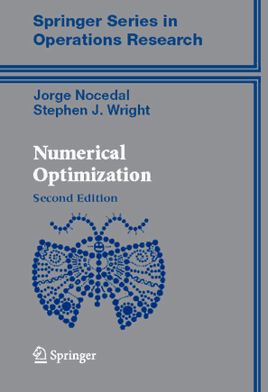
Textbook
Nocedal, Wright

Slide 3
Recap: probabilistic least squares
“noise”
log-likelihood
log-prior
We assume that the noise is independent between measurements and Gaussian. Then our likelihood is:
We assume that w is drawn from an isotropic zero-mean Gaussian prior:
Thus we get:

Slide 4
Other choices for likelihood
log-likelihood
log-prior
The noise can be non-Gaussian. E.g. data can contain outliers, i.e. data points where results strongly deviate from the model predictions
Gaussian likelihood penalizes such large deviations very strongly (its –log is quadratic, hence grows very fast when we move from zero). Even a single outlier is then likely to perturb our estimate of w by a lot.
When outliers are present, we have to use robust ("heavy-tailed") distributions to model the posterior.

Slide 5
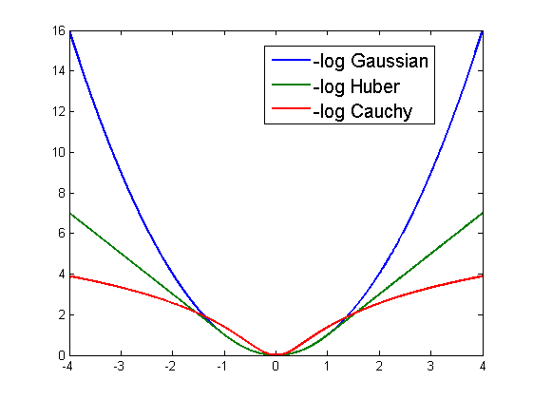
Robust likelihood functions
Cauchy (non-convex, smooth)
Huber (convex, smooth)

Slide 6
Adding robustness to Least Squares
log-likelihood
log-prior
otherwise

Slide 7
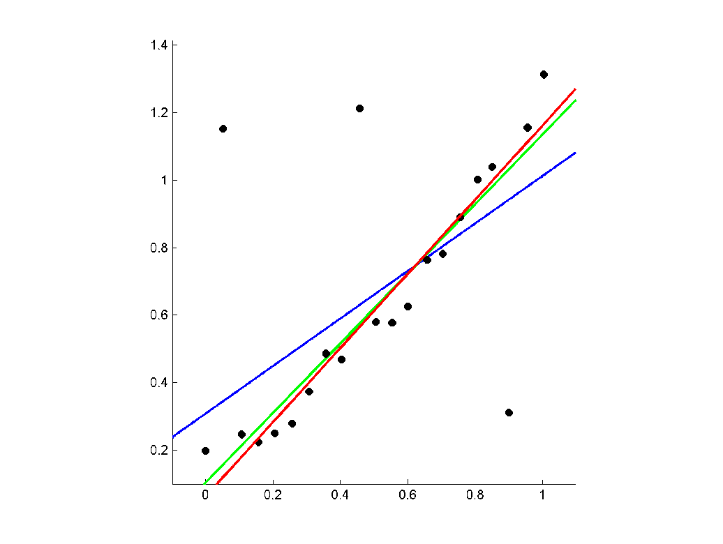
Robust fitting
Gaussian
Huber
Cauchy

Slide 8
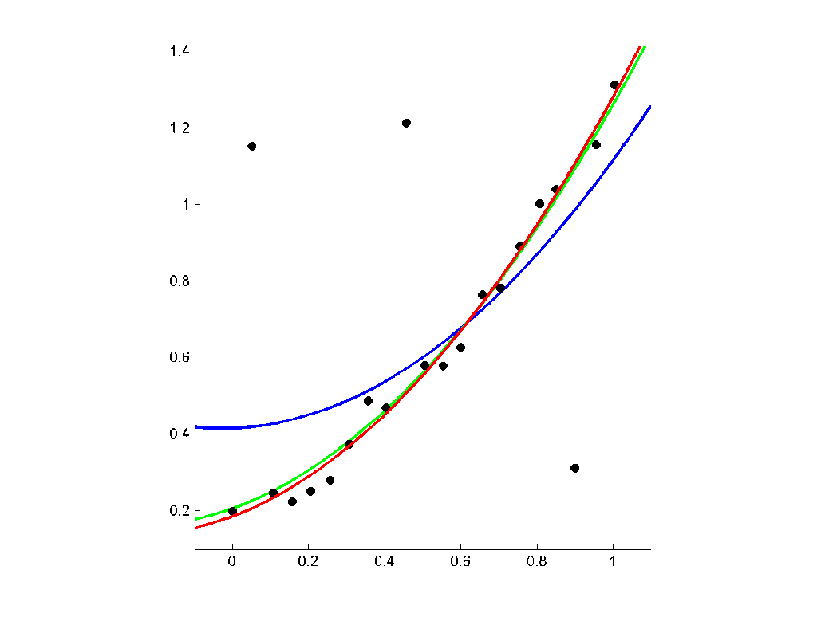
Robust fitting
Gaussian
Huber
Cauchy

Slide 9
Other choices for prior
Popular choices for priors include:
L0-prior, -logP(w) = λ||w||₀ , i.e. number of non-zeros. This lead to interpretable sparse results (in terms of recovered w).
L1-prior, -logP(w) = λ||w||₁ , i.e. sum of absolute values. Interestingly, this also lead to sparse results, and in some conditions to the same result as the previous prior.
||Lw||, i.e. penalizing not the coordinates of w vector themselves but their linear combinations. Many imaging applications penalize large values of partial derivatives of the resulting image
Keywords (for sparsity inducing priors): sparse coding, compressed sensing,…

Slide 10
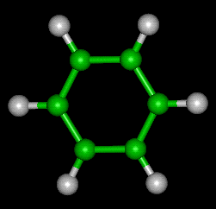
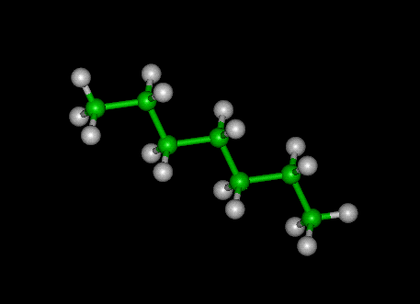
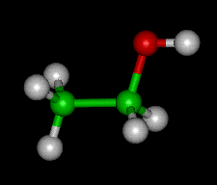
Another non-linear optimization problem
benzene
heptane
Estimation of the molecular shape (from its formula) can be reduced to optimization.
ethanol

Slide 11
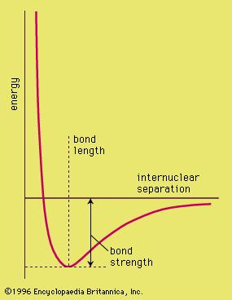
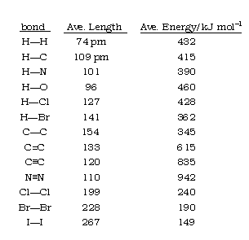
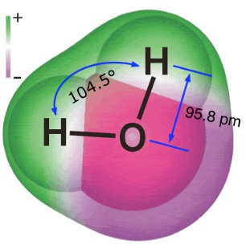
Some tabular data
Potential energy as a function of a bond length

Slide 12
From formula to optimization
(the position of the ith atom)

Slide 13
Newton method (for optimization)
The most important method for
Main idea: iteratively solve
Consider 2nd-order Taylor approximation around x_{t} :
Then we need to solve:
We get:
Notes:
We assume that we can evaluate the second derivatives at any point

Slide 14
Newton method for non-linear equations
“Jacobian”
Newton method for optimization = Newton method for non-linear equations (∇F = 0 )
“Proof”:

Slide 15
1D example (Newton method)
Observation: after x₄, the convergence will be extremely fast

Slide 16
1D example (Newton method)
Observation: before we get close to minimum, we can oscillate wildely (and even diverge)

Slide 17
Newton method: caveat 1
∇F = 0 is a necessary condition for a minimum, not sufficient
Thus, Newton steps may converge to a saddle point or even a maximum
For convex functions, all points with zero gradient are local minima

Slide 18
Newton method: caveat 2
Newton method may prescribe very big steps (especially if ∇²f is near-degenerate)
For very big steps, the Taylor approximation is likely to be invalid (same overshooting behaviour as in the 2nd example)
Solution 1: line search
Solution 2: trust region

Slide 19
General Newton algorithm
Vanilla Newton step:
More realistic Newton involves line search:
Initialize x0
While ||∇f_{k}|| > eps
d_{k} = –∇²f(x_{k})⁻¹ * ∇f_{k};
x_{k+1} = LineSearch(x_{k}, d_{k});
end

Slide 20
Armijo rule for line search
Assume that the search direction is a descent one:
Armijo rule ensures that we find good enough point (not necessarily a minimum):

Slide 21
Strong Wolfe conditions for line search

Slide 22
Backtracking search for Armijo rule
Simplest variant: start with α = 1 and divide it by 2, till Armijo rule is satisfied
More efficient variant: based on the evaluated points fit a polynomial approximation and go towards its minimum, given that it satisfies

Slide 23
Newton method: caveat 3
In high dimensions, the Hessian is expensive to evaluate
In high dimensions, the Hessian is expensive to invert
In very high dimensions, the Hessian is even expensive to store

Slide 24
Recap: Hessian in Levenberg-Marquardt
Easily computable
Easily invertible (when Jacobian is sparse)
Positive definite, well conditioned

Slide 25
Quasi-Newton method
Quasi-Newton methods use the approximation:
Quasi-Newton step:
If , then Quasi-Newton -> Newton.
Quasi-Newton idea: estimate B(x), which is similar to the true Hessian, without evaluating the second derivatives (just by observing gradients).

Slide 26
General quasi-Newton algorithm
Initialize x0, ∇f0 = ∇f(x₀), B₀ = λ Identity
While ||∇f_{k}|| > eps
d_{k} = –B_{k}⁻¹ * ∇f_{k};
x_{k+1} = LineSearch(x_{k}, d_{k});
∇f_{k+1}⁼ ∇f(x_{k+1})
B_{k+1} = Update(B_{k}, ∇f_{k+1} ,∇f_{k});
end
Quasi-Newton idea: estimate B(x) which is similar to the true Hessian, without evaluating the second derivatives (just by observing gradients).

Slide 27
Estimating gradient without differentiation
How to estimate Hessian without evaluating second derivatives?
Analogous question: how to estimate the gradient without evaluating first derivatives?
Assume the function is approximately linear (the gradient is constant). Then we can estimate it just by fitting linear function to points:

Slide 28
Estimating gradient without differentiation
Analogous question: how to estimate the gradient without evaluating first derivatives?
Assume the function is approximately linear (the gradient is constant). Then we can estimate it just by fitting linear function to points:

Slide 29
Quasi-Newton update
B_{k} = Update(B_{k-1}, ∇f_{k} ,∇f_{k-1});
For a real Hessian and a quadratic function (where 2nd order approximation is perfect), we would have:
Therefore, we seek B_{k} that fits:
This is D equations on D²/2 variables, so we need further assumptions to impose on B_{k}

Slide 30
“Symmetric Rank 1”-update
Quasi-Newton with SR1 (“Symmetric Rank-1”) updates:
Notes:
v^Ts_k is a scalar, hence (2) => (3)
(4) results from plugging (3) back into (2)

Slide 31
“Symmetric Rank 1”-update

Slide 32
“Symmetric Rank 1”-update
Works well unless the denominator vanishes
Fix: skip the update if denominator ≈ 0
More principled solution: Rank-2 updates
A Rank-2 method (BFGS) is known as “the best universal” unconstrained optimization method for smooth functions

Slide 33
Final words about quasi-Newton methods
Quasi-Newton (in particular, BFGS) are widely regarded as the most robust and versatile methods for unconstrained smooth optimization
Another smart idea: maintain and update B_{k}⁻¹. In this way we do not need to invert matrices in order to solve for steps!
For quadratic functions, some update rules converge to the true Hessian

Slide 34

Application: structure-and-motion
Ultimate goal (multiview stereo): given an unstructured collection of photographs of an object recover/build its 3D model
Intermediate step (structure-and-motion): estimate the position of cameras and a sparse set of points in a global reference frame

Slide 35



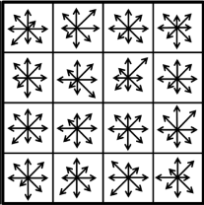

Automated feature detection
High-dimensional descriptor invariant to many transformations
Slide from Brown and Lowe

Slide 36
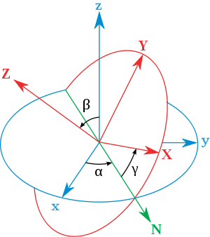
Math behind structure-and-motion

Slide 37
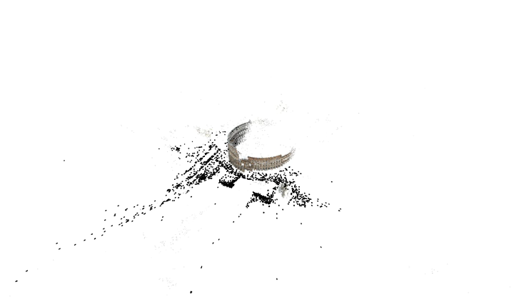
A result of structure-and-motion
[Agarwal, Snavely, Simon, Seitz, Szeliski, "Building Rome in a Day", CVPR 2009]

Slide 38
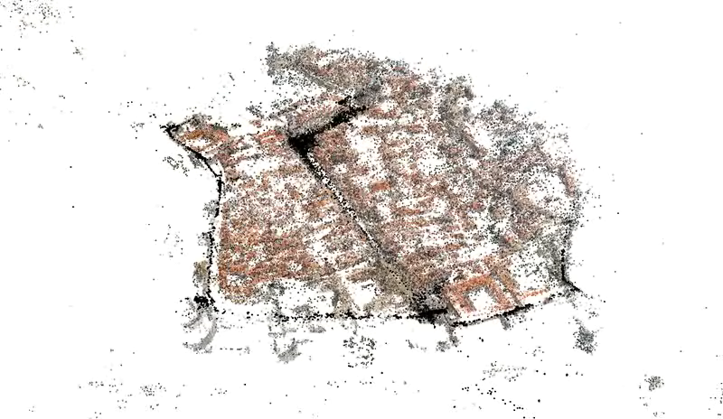
A result of structure-and-motion
[Agarwal, Snavely, Simon, Seitz, Szeliski, "Building Rome in a Day", CVPR 2009]

Slide 39
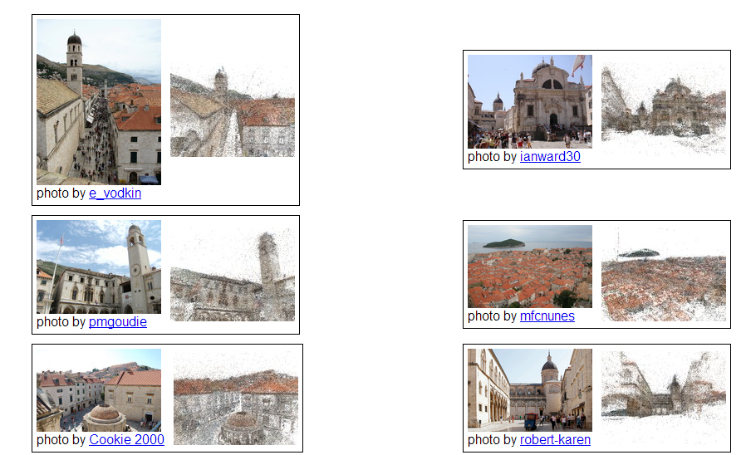
[Agarwal, Snavely, Simon, Seitz, Szeliski, "Building Rome in a Day", CVPR 2009]

